Slide 1

GLOBAL INFLATION ANALYSIS DASHBOARD
Uma Selvaraj - Team Lead
Zejing Liang (Jean)
Bailey Strauch
Wendy Ware
Notes:
Presenter: Wendy
Good Evening, everyone!
Jean, Uma, Bailey and I are excited to present our interactive inflation analysis dashboard.
The dashboard allows users to explore and visualise inflation data across different countries and time periods, helping one understand the patterns and factors influencing inflation globally.
I will talk you through the objectives of this project, and give you a quick run-through the database.
Jean will then describe the define, design, develop and deploy process.
Uma and Bailey will then do a deep dive into two countries that they have selected from the dashboard.
They will discuss the associated inflation trends for these two countries.
We will hopefully have some time at the end to give you time to explore the dashboard.

Slide 2

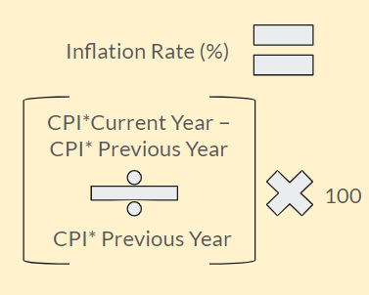
PROJECT OBJECTIVE
Create an interactive dashboard to visualise global inflation trends from 1980 to 2024.
Notes:
Presenter: Wendy
Our goal is to create an interactive dashboard to visualise global inflation trends from 1980 to 2024.

Slide 3

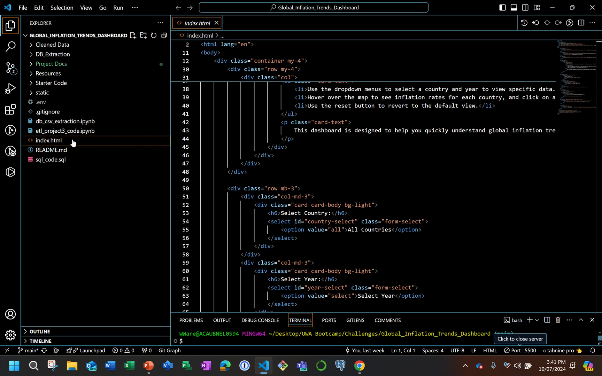
Notes:
Presenter: Wendy
I have a short animation showing the dashboard, which I am now going to play and speak to.
I am now doing to handover to Jean who will be presenting the design, define, develop and deploy process.
Thanks, Jean.

Slide 4







2
kaggle.com
Data Transform
1
Data Extract
3
Data Load
6
Deploy
4
Database Export
Publish
5
Design & Test
Notes:
Presenter: Jean
We used a fairly routine and simple process:
We downloaded the data in csv format from Kaggle.com
We then cleaned the data, doing some simple evaluations in Python
We then loaded the data into PostgreSQL using sql queries
I will discuss the database schema on the next slide
We then exported the data from the database as csv files using Python
The dashboard development work was done using html and javascript (using the same methodology as the one that we used in class)
Our mapping was done using GeoJSON
The new tool that we used was Flourish.studio – this was used for the race bar chart
All collaboration was done in Github – we managed our project using Github Projects and we published using Github Pages

Slide 5
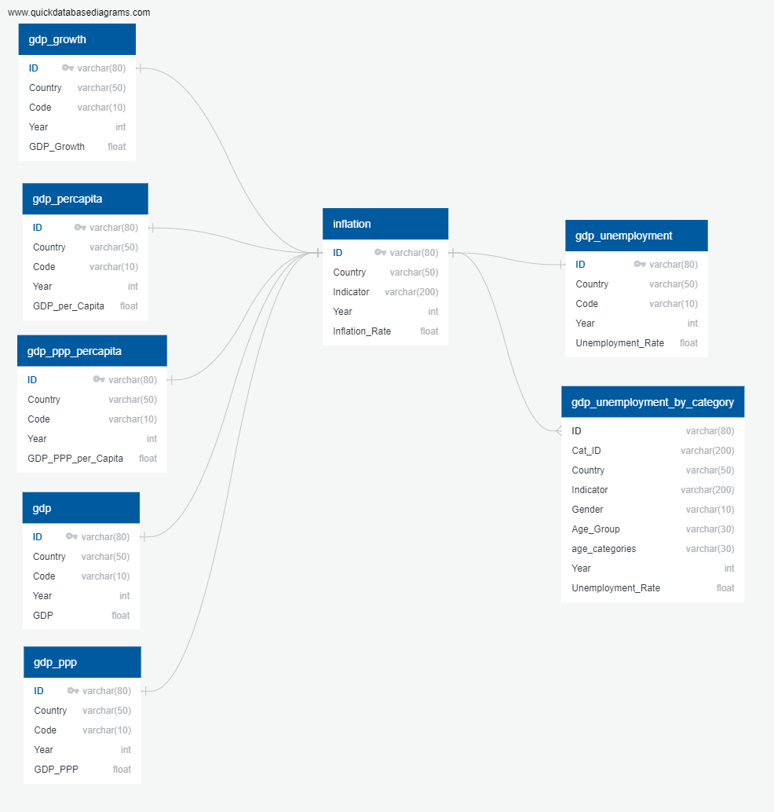
Number of records | 8820
Number of countries | 196
Number years | 45
Notes:
Presenter: Jean
This is the database schema
It is important to note that for the dashboard – due to time constraints – we only used the data from the inflation. This leaves a lot of opportunity to enhance functionality of the dashboard in the future.
In terms of the data, we used inflation data from 196 countries spanning the years 1980 to 2024. There are over 8000 records in our database.

Slide 6
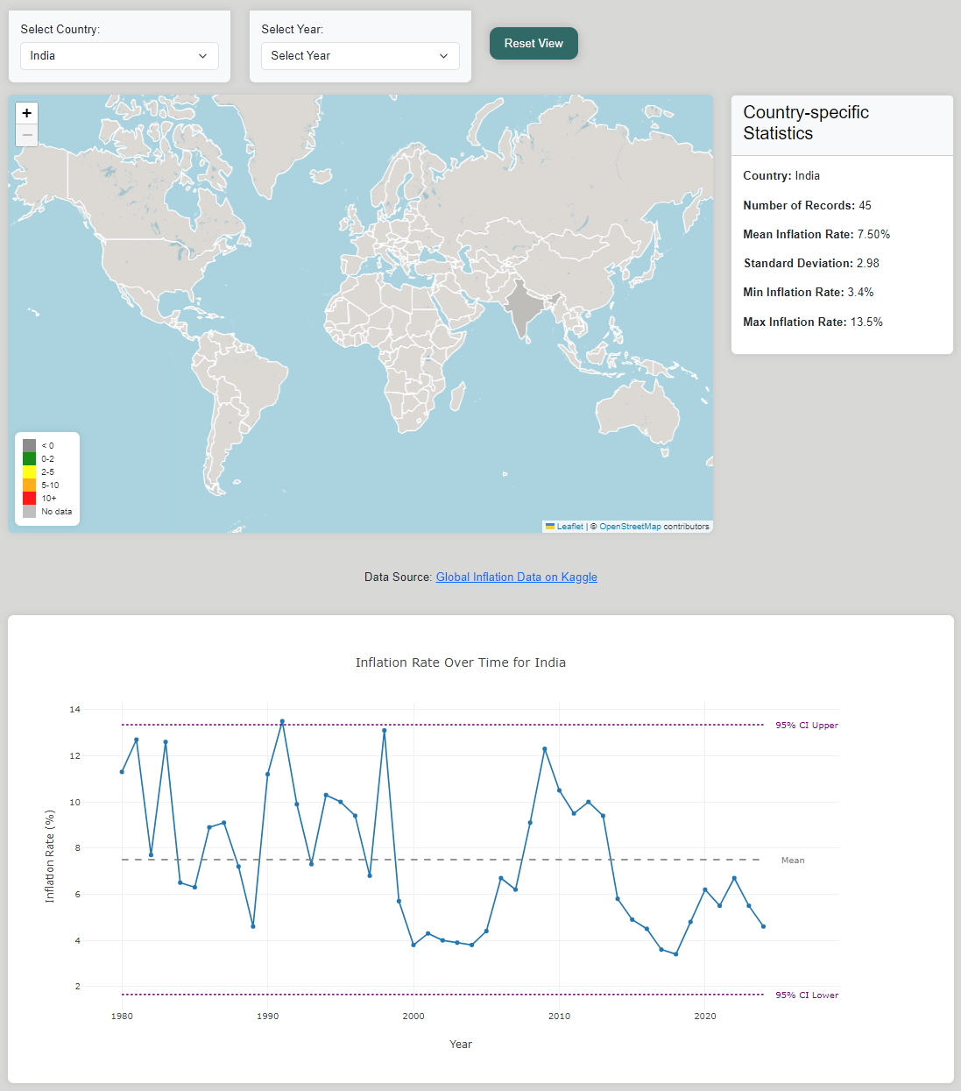
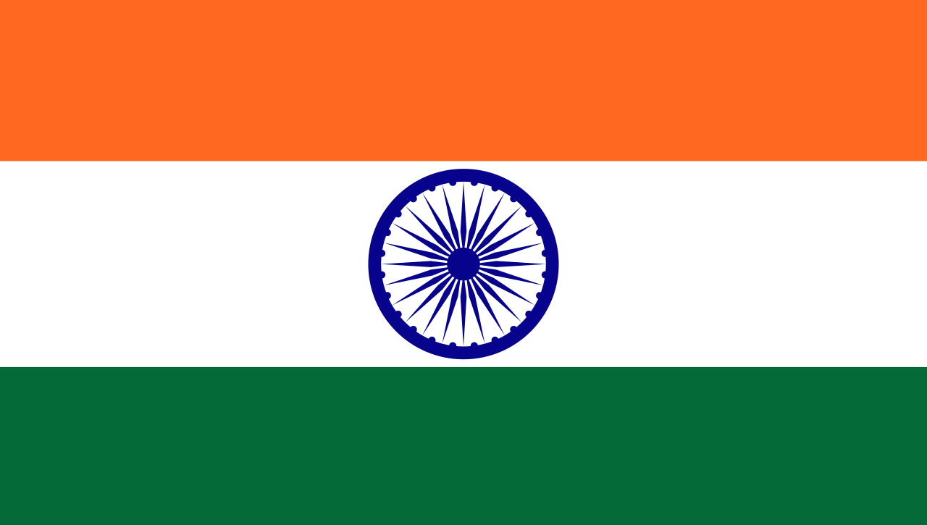
INDIA
Notes:
Presenter: Jean
I am now going to handover to Uma to speak about India’s inflation jpourney – Uma, take it away!

Slide 7
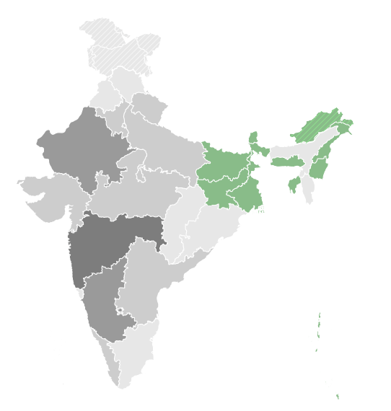
INDIA
Notes:
Presenter: Uma
India, located in South Asia, is known for its diverse culture and rich natural resources.
Since gaining independence in 1947, India's economy has evolved significantly.
It shifted from being mostly agriculture-based to focusing on industry and services.

Slide 8
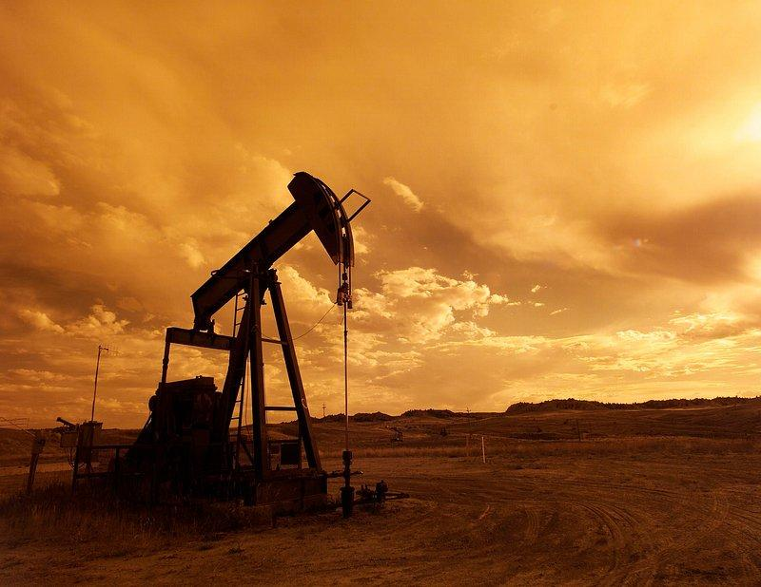
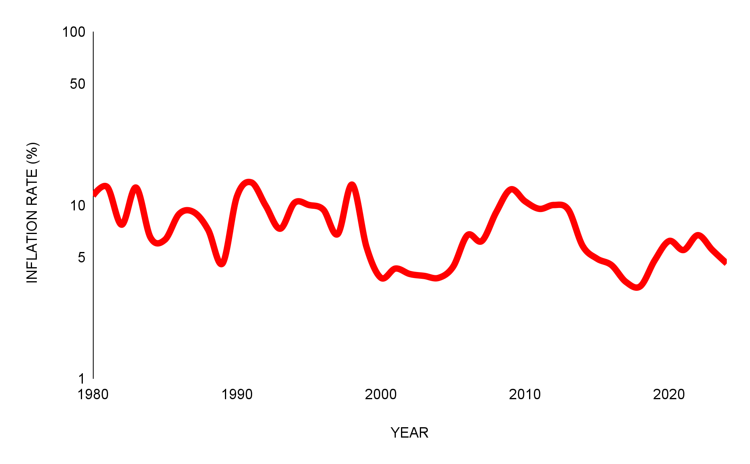
INDIA
1980s
Above: Inflation instability in response to global oil price shocks.
Notes:
Presenter: Uma
During the 1980s, India experienced fluctuating inflation rates, influenced by global oil price shocks and domestic economic policies
Inflation surged during the early part of the decade, peaking at over 11% in 1981, but moderated towards the latter half, averaging around 8% by the end of the 1980s due to fiscal reforms and stabilization efforts.

Slide 9
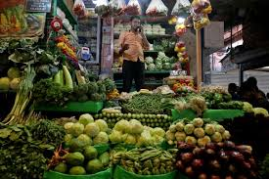

INDIA
1990s
Above: Economic reforms like deregulation, lower tariffs, and inviting foreign investment.
Notes:
Presenter: Uma
In the 1990s, India's inflation initially went up after economic reforms like deregulation, lower tariffs, and inviting foreign investment. As the decade progressed, inflation slowed down because the economy adjusted to these changes and the government managed money more carefully.

Slide 10



INDIA
Inflation-targeting Measures
2000s
Economic Growth
Reserve Bank of India
Notes:
Presenter: Uma
The 2000s saw a more stable inflation environment in India, characterised by single-digit rates. Economic growth, fueled by the IT boom and rising middle-class consumption, contributed to moderate inflation.
The Reserve Bank of India (RBI) implemented inflation-targeting measures, focusing on managing money supply and interest rates to control price levels while supporting growth.

Slide 11
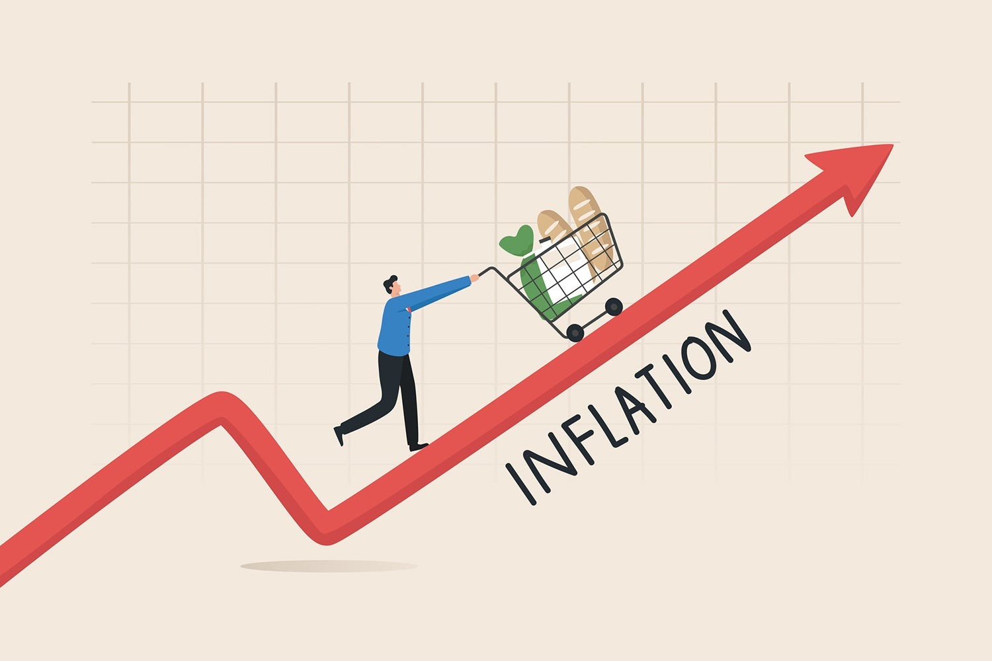
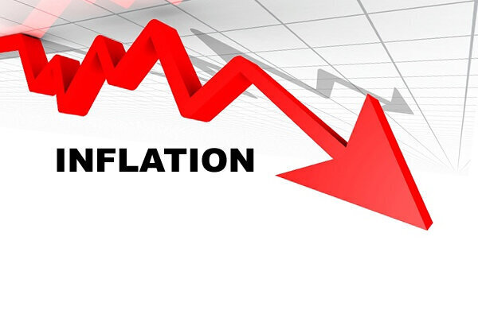
INDIA
High to low inflation over the decade
2010s
Notes:
Presenter: Uma
The early 2010s continued to experience high inflation, peaking at 10.5% in 2010. However, tight monetary policies and economic measures helped bring inflation under control.
By the mid-2010s, inflation stabilised around 4-6%. In 2018, the inflation rate was at a low of 3.4%, reflecting effective policy measures.

Slide 12

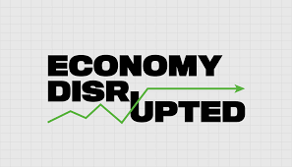
INDIA
2020s
Notes:
Presenter: Uma
The early 2020s were marked by the COVID-19 pandemic, causing economic disruptions and fluctuating inflation rates.
For example, in 2020, the inflation rate was 6.2%, influenced by supply chain issues and policy responses. However, recent data shows a trend towards stabilization, with a forecasted rate of 4.6% in 2024.

Slide 13


PERU
Notes:
Presenter: Uma
I am now going to handover to Bailey who will tell you a bit about Peru – Bailey, over to you.

Slide 14
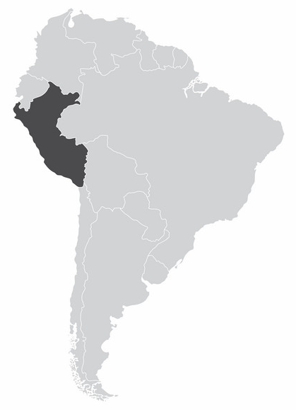
PERU
Notes:
Presenter: Bailey
For the next few slides I’ll be covering the inflation rates from 1980 to the present in Peru.
I’ll start us off with a quick background on Peru.
Peru is located to the west of South America and is known for a diverse landscapes of Beaches, Jungles, Mountains and even a Desert or two.
Their main exports are from fish exports and a variety of mining exports.

Slide 15

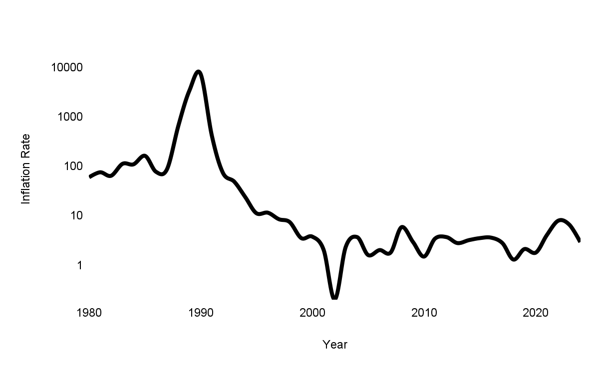
PERU
1980s
Above: The 20 sol note, used since 1850s** until 1987 due to inflation rates increasing drastically.
Notes:
Presenter: Bailey
The 1980s were marked by economic challenges and rising inflation in Peru. Throughout the decade, inflation rates gradually increased due to economic mismanagement, political instability, and an external debt crisis. This set the stage for the hyperinflation period that would peak at the end of the decade.

Slide 16
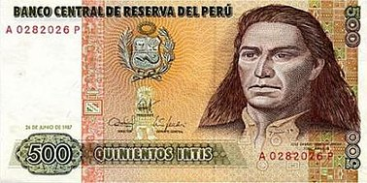
PERU
Early 1990s
Above: The 500 inti note based on the Incan sun gods name ‘Inti’. Was used between 1987 and 1991 before being removed from circulation due to peak in hyperinflation.
Notes:
Presenter: Bailey
The year 1990 was a pivotal moment in Peru's economic history, characterised by hyperinflation peaking at over 7,000%. This period of severe economic crisis caused widespread social unrest and highlighted the urgent need for drastic economic reforms. The hyperinflation of 1990 was one of the most significant economic challenges Peru faced.

Slide 17
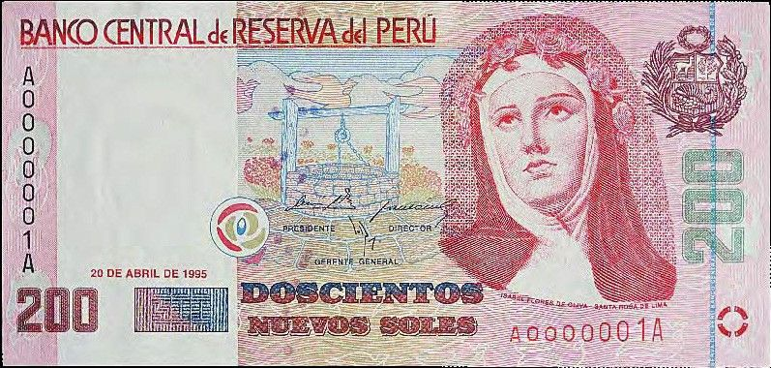
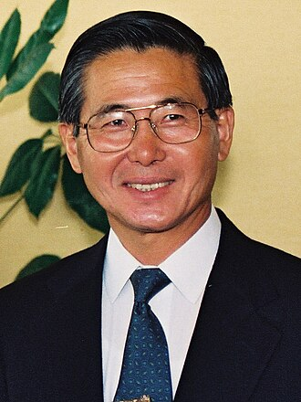
PERU
1990s
Above: The 200 sol note. After the inti was removed a new currency with the same name as the prior, that being sol, with new enhanced features to reduce the inflation.
Right: President Alberto Fujimori, lead of structural reforms leading to stabilisation of the economy.
Notes:
Presenter: Bailey
In the 1990s, Peru underwent significant economic reforms under President Alberto Fujimori. These reforms included liberalization of the economy, privatization of state-owned enterprises, and stabilisation programs supported by the International Monetary Fund. By the late 1990s, these efforts successfully reduced inflation rates to single digits, marking a period of economic stabilization and growth.

Slide 18
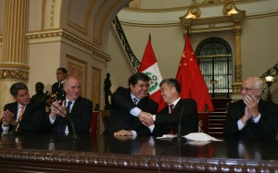
PERU
2000-2010
Above: 2010 saw to a new free trade deal between Peru and China, which will see to greatly benefiting its inflation rates over the next few years**
Notes:
Presenter: Bailey
The 2000s and 2010s saw continued economic growth and controlled inflation rates. Financial institutions were strengthened, and Peru became an attractive destination for foreign investment. The government also pursued numerous trade agreements, which further integrated Peru into the global economy. Inflation remained moderate, contributing to a stable economic environment.

Slide 19
PERU
2010-2020
Notes:
Presenter: Bailey
In the 2010s and early 2020s, Peru faced new economic challenges. While inflation rates remained relatively stable, the global financial crisis and political instability impacted economic performance. More recently, the COVID-19 pandemic caused significant disruptions, leading to fluctuations in inflation rates. The government has continued to implement policies to mitigate these challenges and support economic recovery.

Slide 20
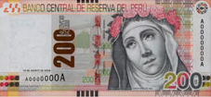
PERU
2020+
Above: The 200 sol note given a new more modern design with new features to help with piracy**
Notes:
Presenter: Bailey
From 2020 to 2024, Peru is navigating the post-pandemic recovery. Inflation rates have been closely monitored as the country implements new government policies to stimulate economic growth. The future outlook remains cautiously optimistic, with a focus on sustainable development and economic resilience. It will be crucial to continue monitoring economic indicators to ensure a stable and prosperous future for Peru.

Slide 21
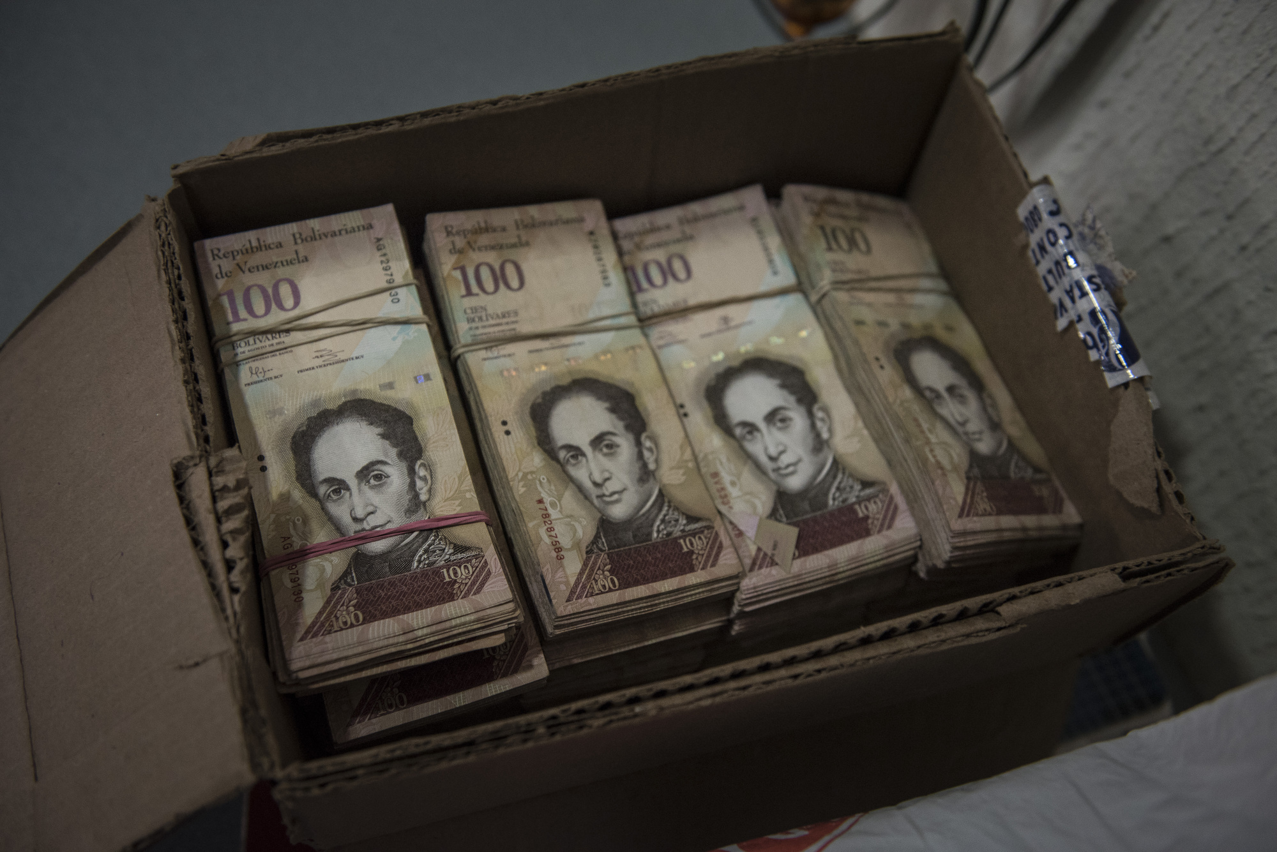
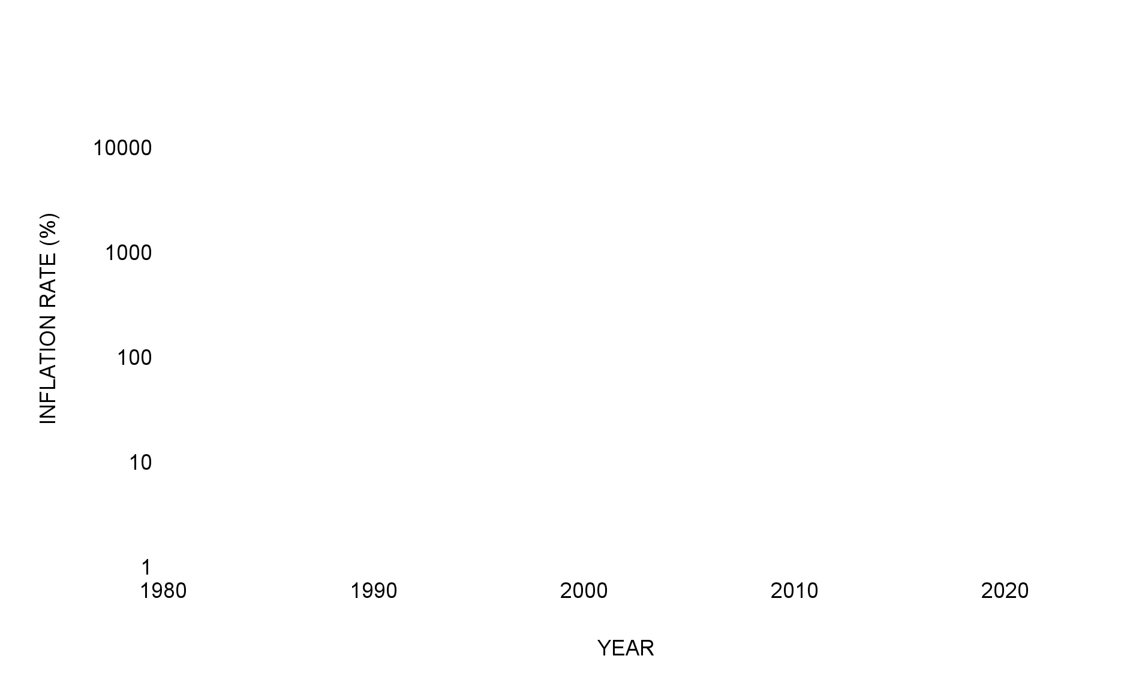

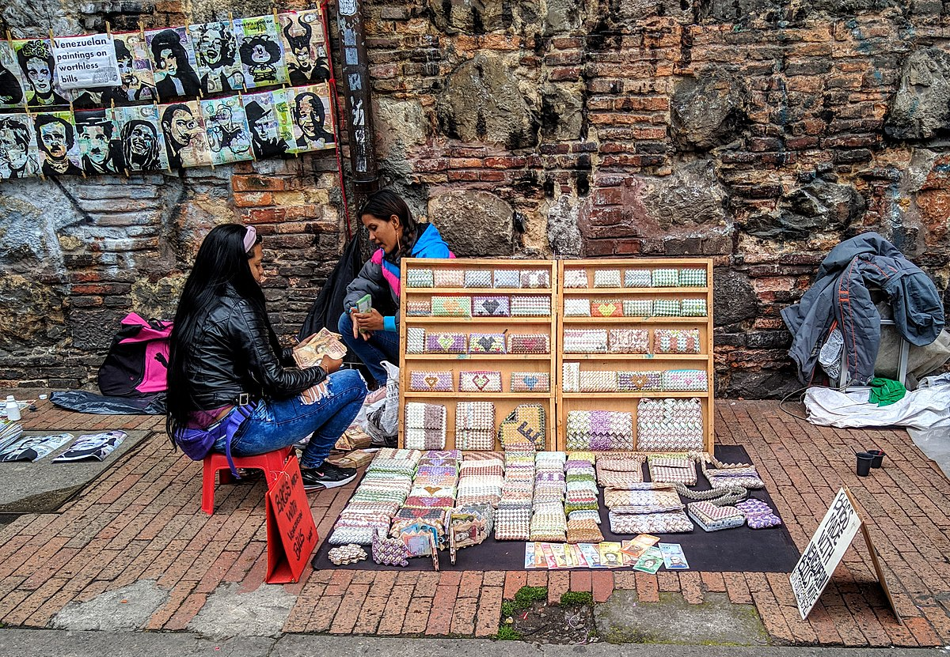
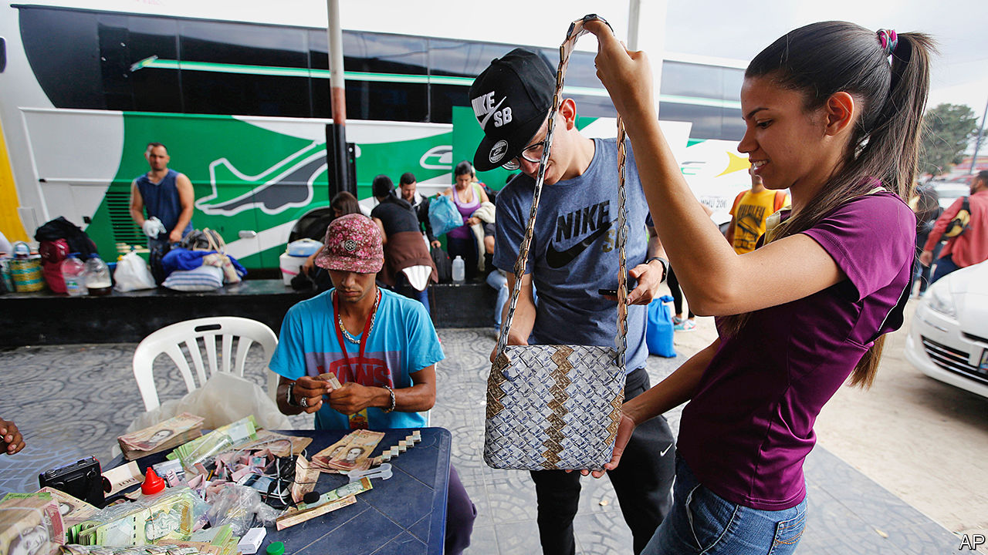
VENEZUELA
1980s
Notes:
Presenter: Bailey
Venezuelan Hyperinflation Example:
Venezuela is a prime example of hyperinflation. Over the past decade, the country has experienced an extreme increase in prices, with inflation rates reaching as high as 1,000,000% in some years.
Cause: The primary cause of this hyperinflation is the government's excessive printing of money to cover budget deficits, combined with a collapse in oil prices, which is Venezuela's main source of revenue. This led to a drastic decrease in the value of the Venezuelan bolívar.
Log Scale Need: To accurately represent such extreme values, we use a logarithmic scale on the vertical axis. This helps in visualizing both the high inflation rates and the more moderate rates in a way that is easy to interpret. A log scale compresses the large range of values, making it possible to see patterns and trends that would otherwise be obscured.

Slide 22
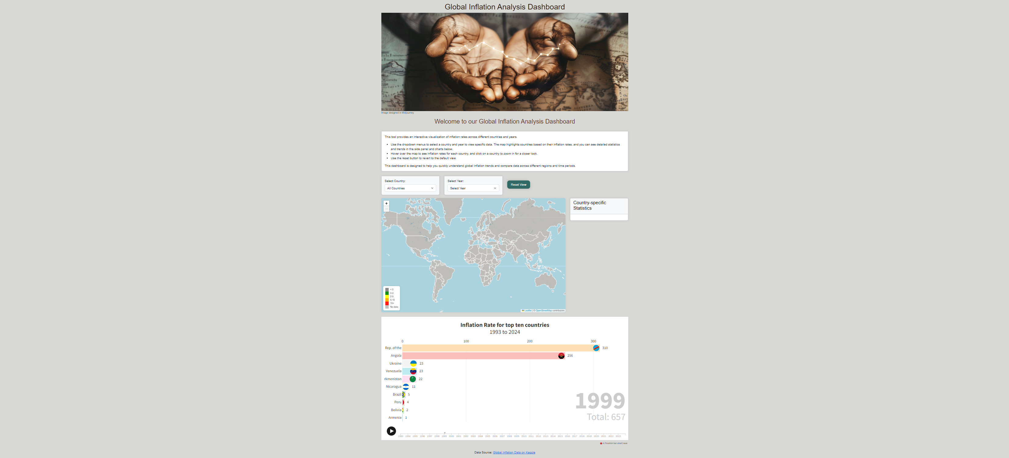
[LINK - Published]
Notes:
Any question or special requests?

Slide 23

THANK YOU

